Slide 1
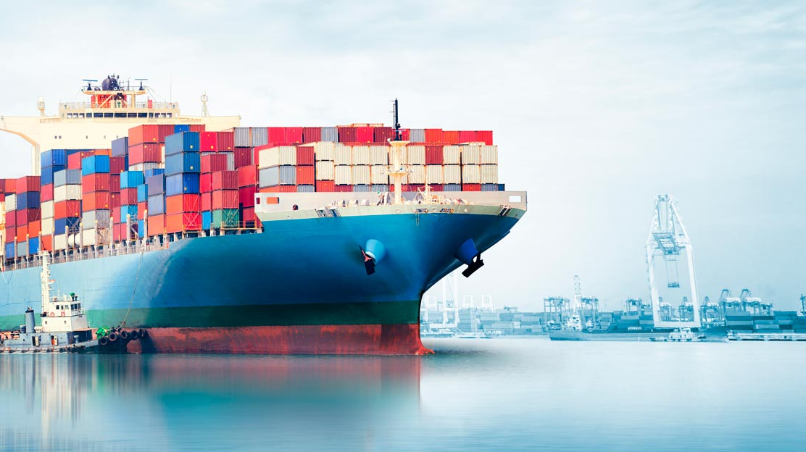
Progress sprint 6 @ Saab
27-11-2019

Slide 2
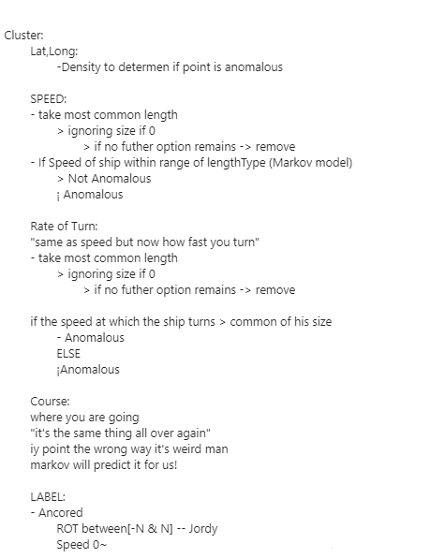
First Plan®
Step 1: Clustering to find anomalies
Based on different combinations of attributes
Step 2: Design RNN for classification
Step 3: Feed data to RNN
Step 4: Find anomalies

Slide 3
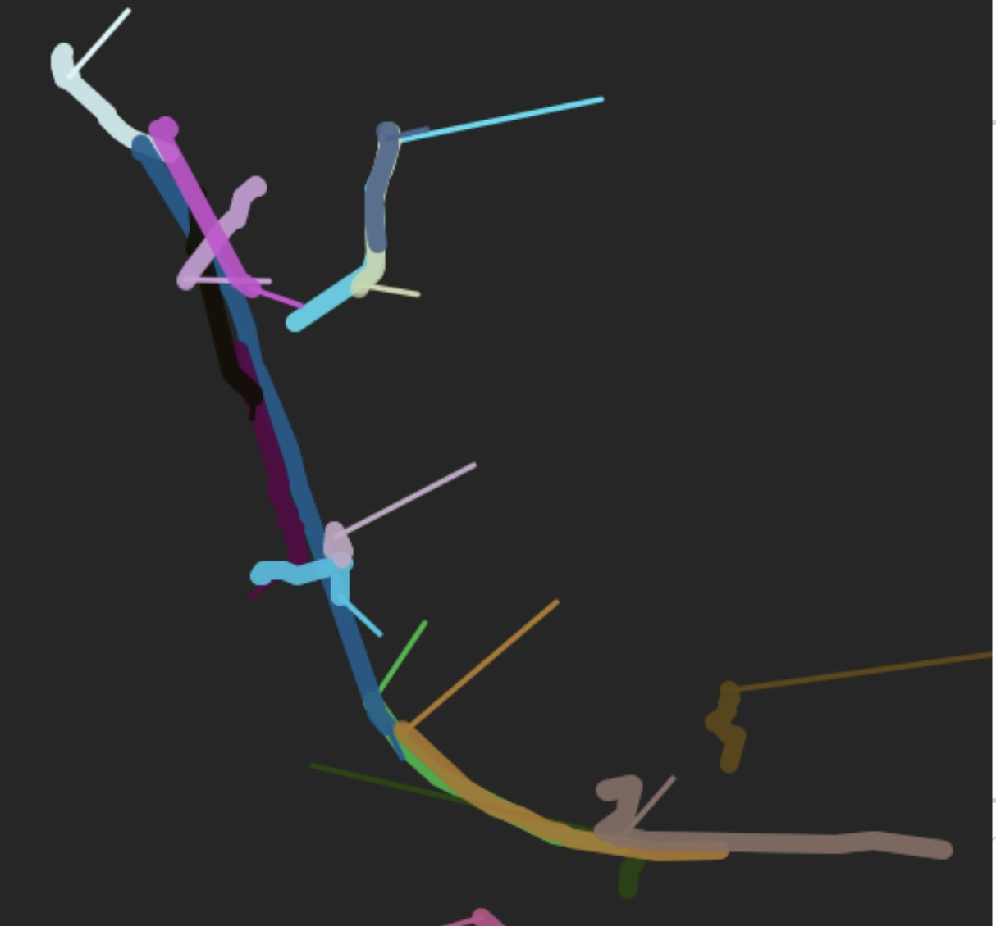
Internal Presentation
Presenting our plan® to the groups/teachers

Slide 4
Jeroen
“No this is going the wrong way.” – Jeroen 2019
“Go back to predicting because you need a Ground Truth.” – Jeroen 2019

Slide 5

The void™
Predict ship routes?
Cluster?
Predict?
Cluster?

Slide 6
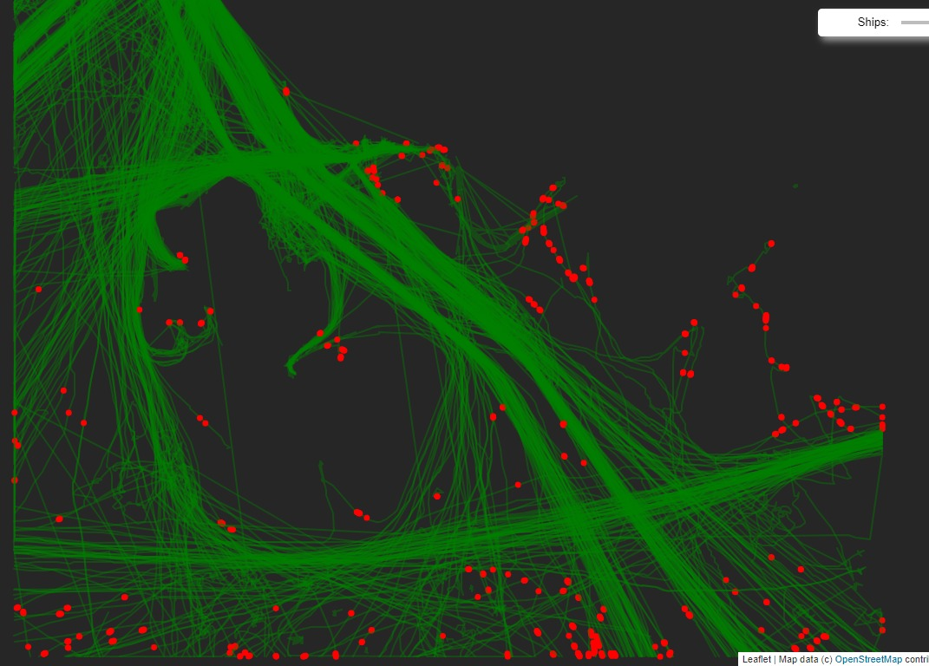
Intermediate work
Based on density

Slide 7
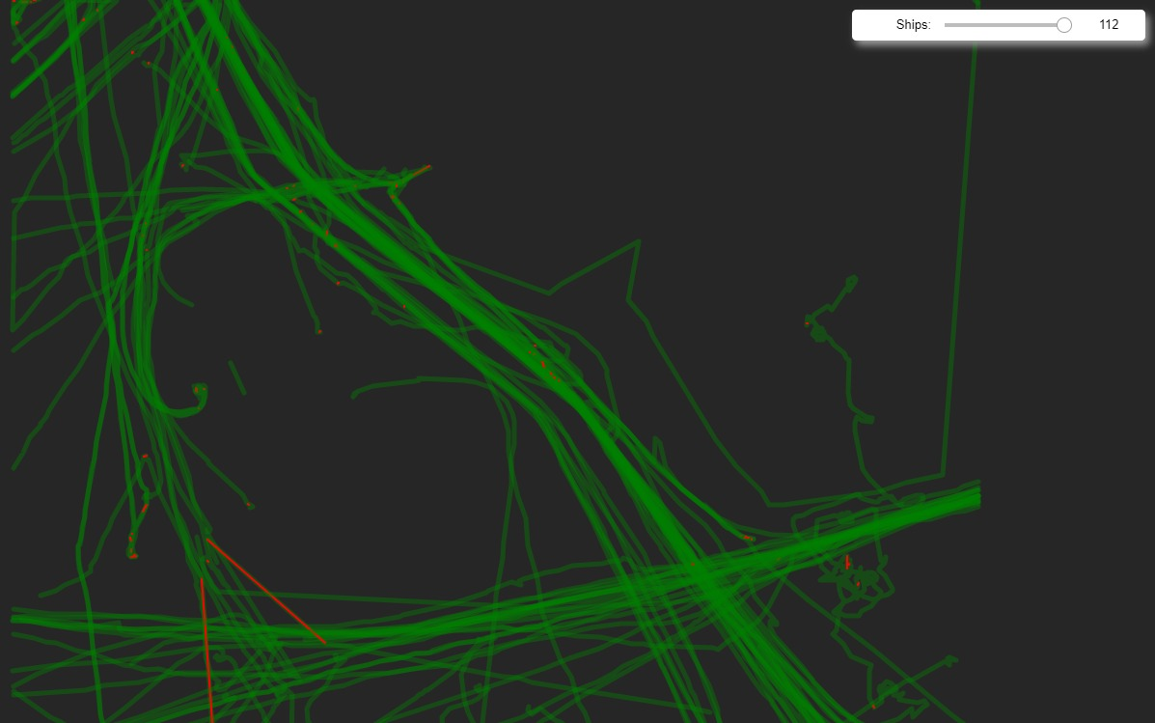
Intermediate work
Based on speed

Slide 8

The paper®
Finished: Introduction, Conceptual Framework
In progress: Literature study
To do: Results, Discussion, Conclusion, Preface, Abstract

Slide 9
Result:

Slide 10


New Plan®
Sponsored by: Jeroen

Slide 11
The Plan®
Step 1: Predict 1 point from 2 points using just Lat, Lon
Step 2: Add more features as input (speed, timesteps, orientation/course * sin+cos)
Step 3: Stack LSTM layer on top, adjust to LSTM model
Step 4: Stack Classifier on top
Step 5: Add random routes as anomalies
Make them realistic (based on existing routes) but add extreme values (like speed)
Step 6: Get classification results (Anomaly/Non anomaly)

Slide 12
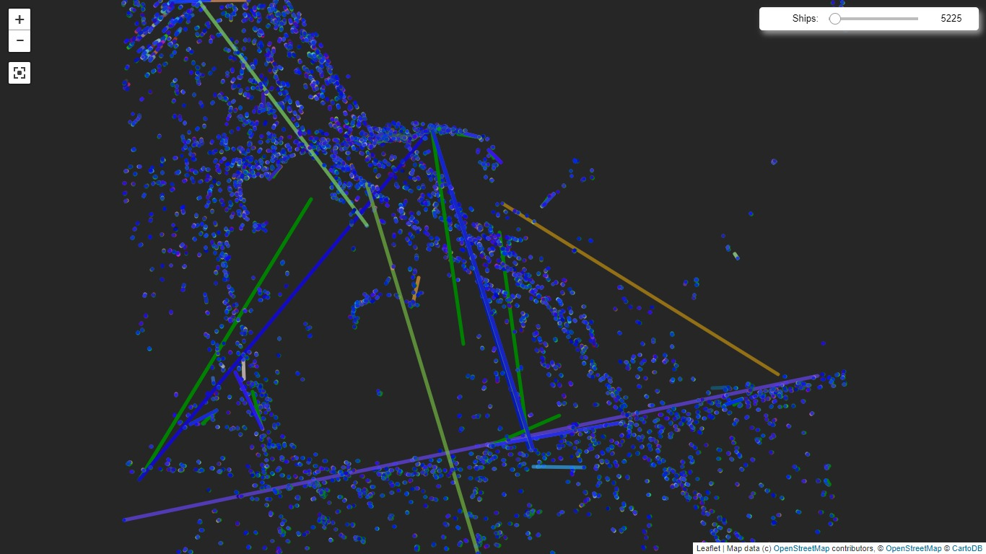
Whole map - Uncleaned

Slide 13
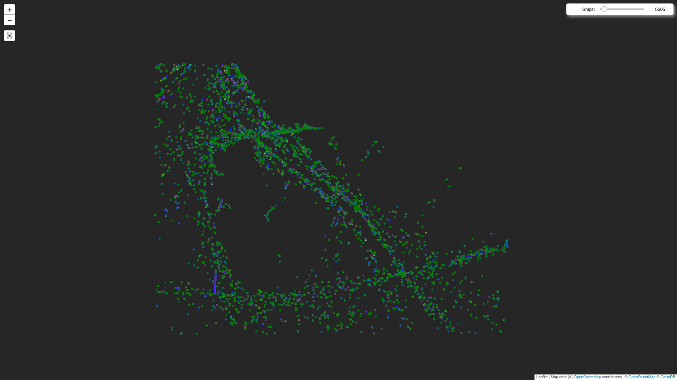
Whole map - Cleaned

Slide 14
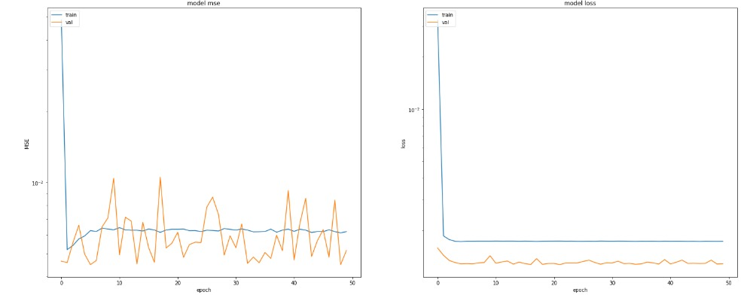
First step results - Uncleaned

Slide 15
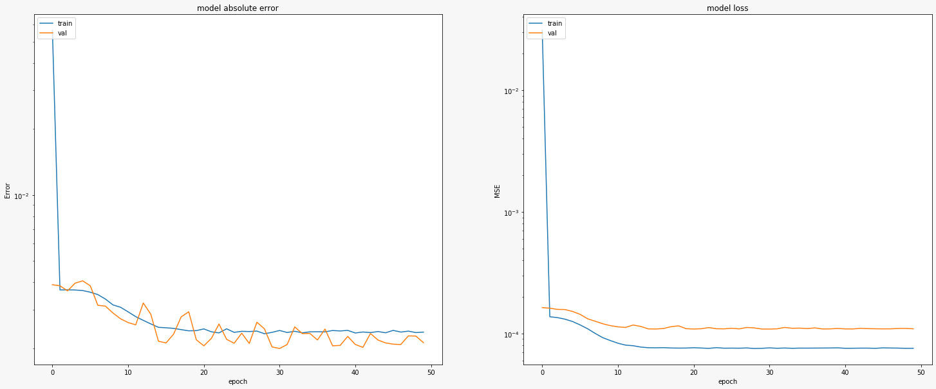
First step results - Cleaned

Slide 16
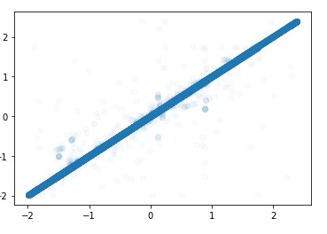
First step results - Uncleaned
Real values vs Predicted values
Normalized data

Slide 17
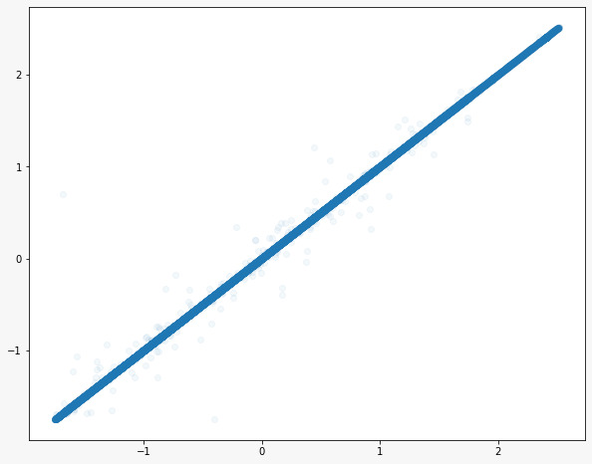
First step results - Cleaned
Changed alpha
Even less outliers

Slide 18
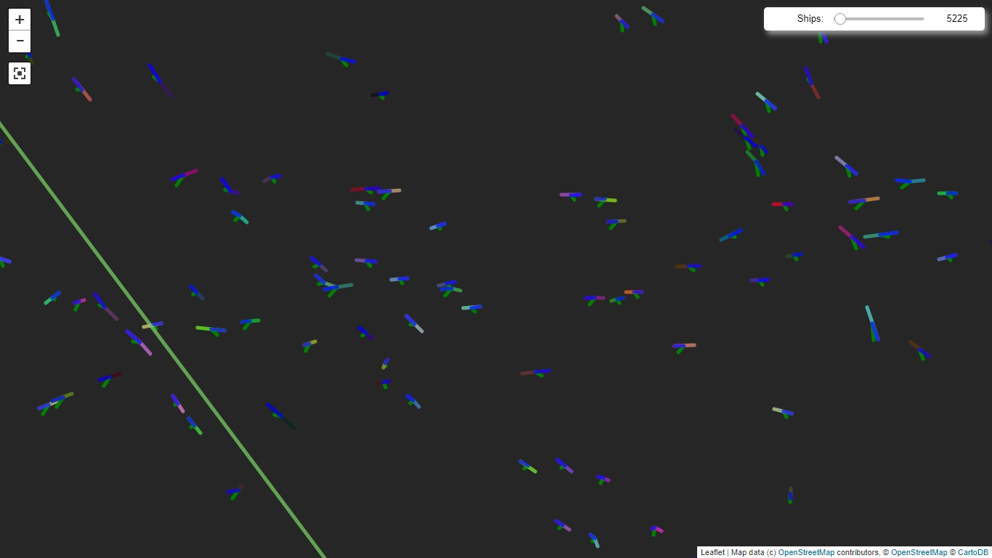
Predictions from first NN - Uncleaned
Green = prediction
Blue = Real course

Slide 19
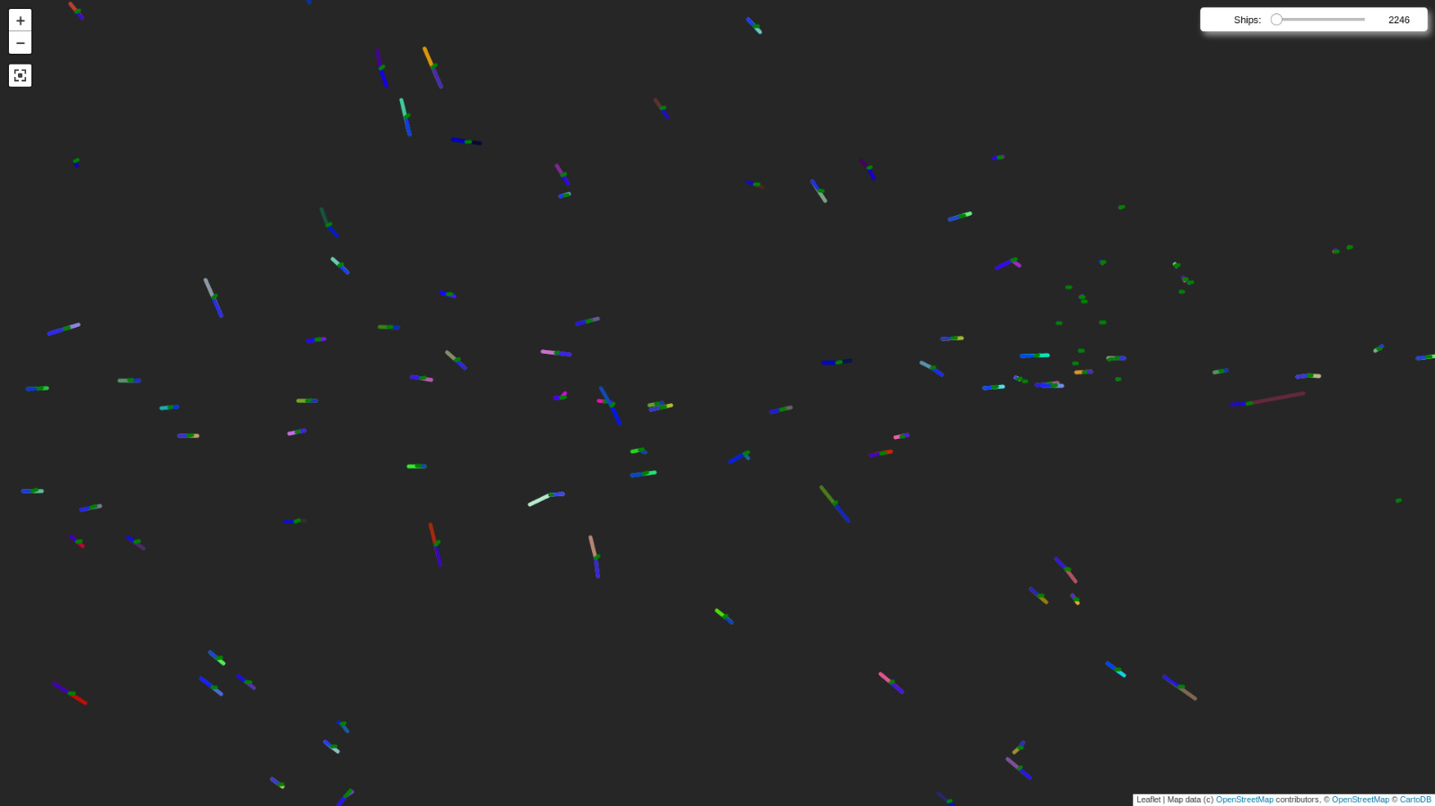
Predictions from first NN - Cleaned
Same route
Crossing
Green = prediction
Blue = Real course

Slide 20
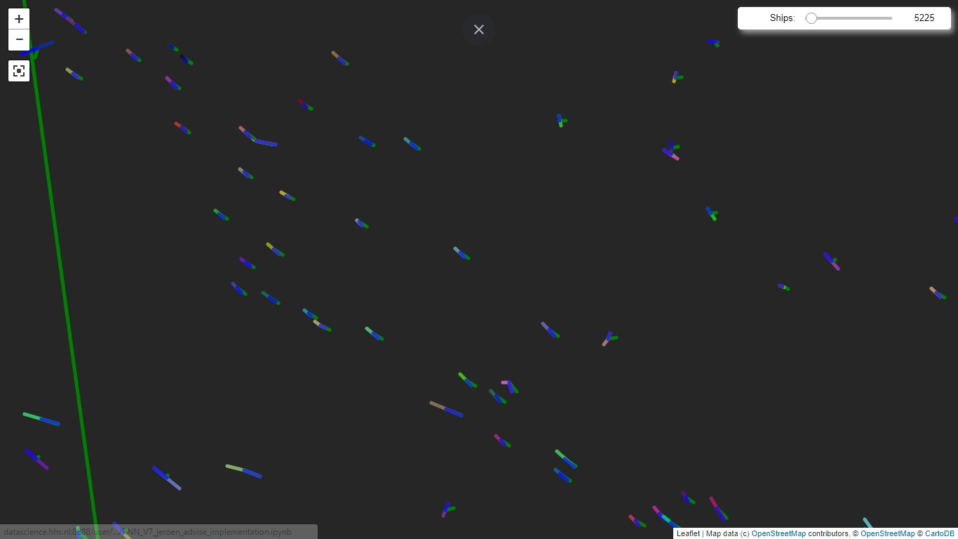
More predictions from first NN - Uncleaned
Green = prediction
Blue = Real course

Slide 21
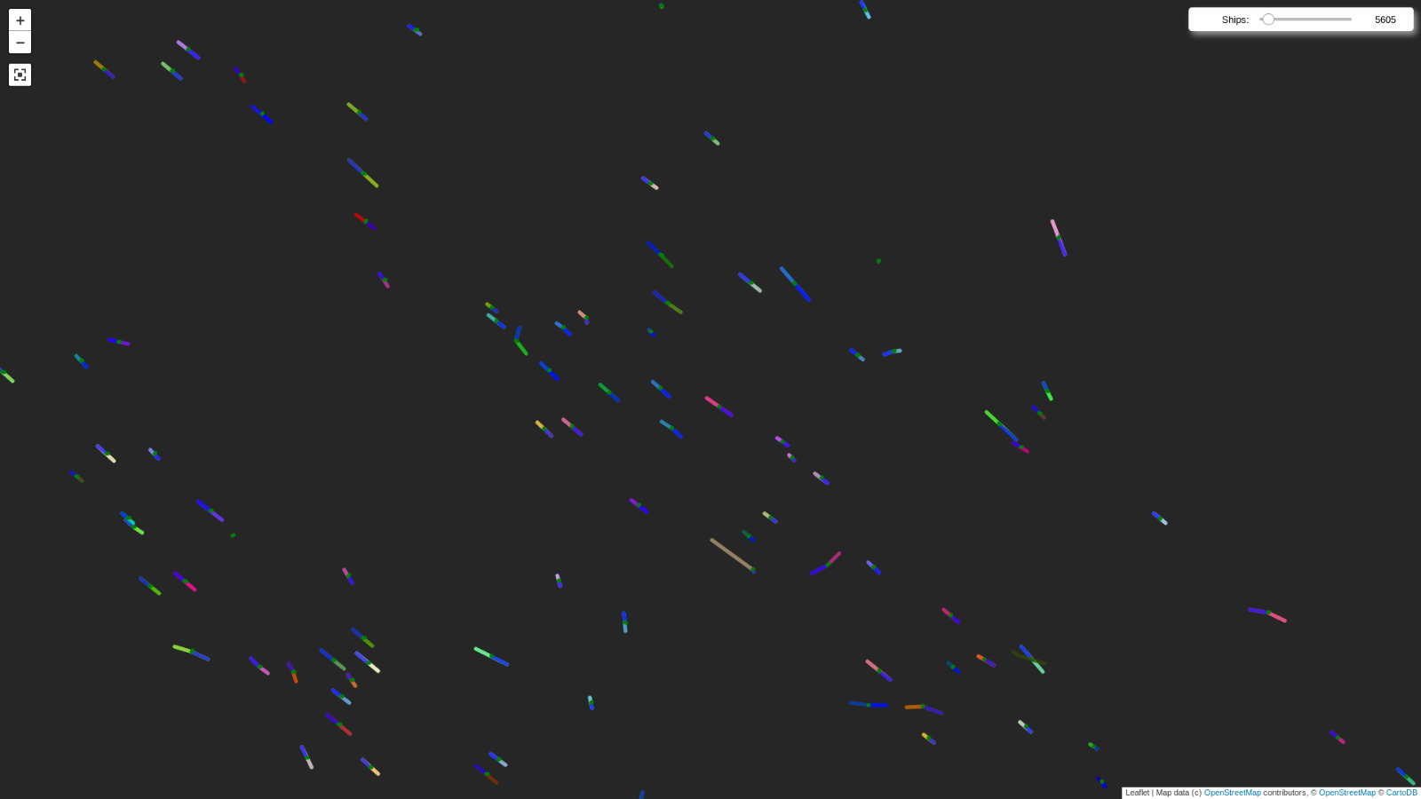
More predictions from first NN - Cleaned
Green = prediction
Blue = Real course

Slide 22
Questions/Feedback?

